Slide 1




Experiment
Scenario
IoT Sensor₃
Smart Broker₁
IoT Sensor₃
Data Center
IoT Sensor₃
Wireless router
IoT Sensor₃
Smart Broker₂
Sort | Device | Compute Power
IoT Device | Raspberry Pi 3 B+ | 1.4GHz ARM Cortex-A53 MP4, 1GB RAM
Local Share Manager | Raspberry Pi 3 B+ | 1.4GHz ARM Cortex-A53 MP4, 1GB RAM
IoT Sharing Platform | CentOS Server | Intel® Core™ i5-7400 (3.50 GHz), 8GB RAM

Slide 2
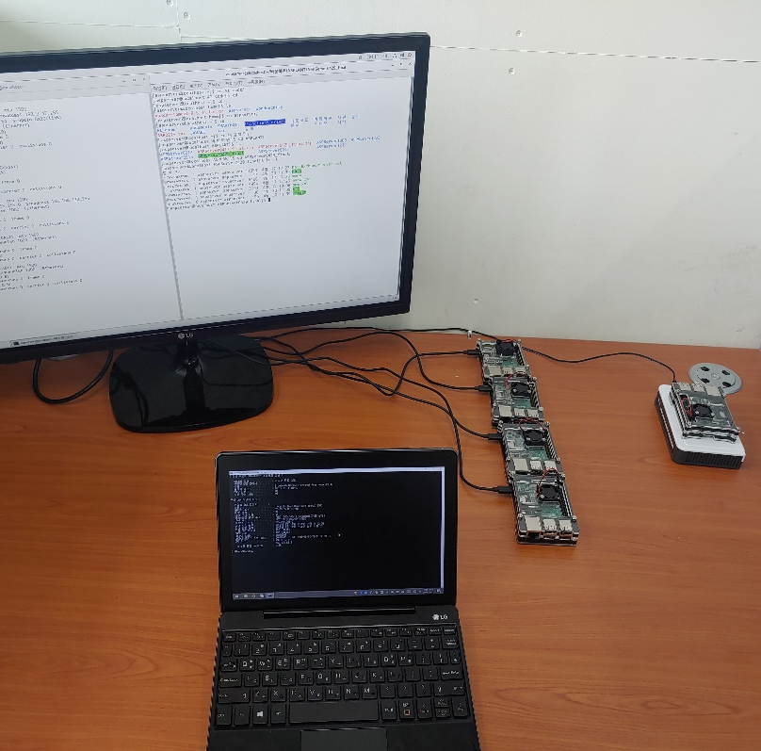


Experiment
(a)
(b)
(1)
4km
IoT Sensors
(2)
(1)
Smart
Edge
Broker
(2)
Data Center
(3)
(3)
IoT Service Server
MQTT
HTTP

Slide 3

Experiment
Experiment 1
Can it reduce Latency
2. Rescive Data &
Compare Time
Smart Broker₁
IoT Sensor₁
Route A
IoT Service
1. Send SendTime
Route B
Wireless router
Data Center
In Internet

Slide 4
Evaluation
Latency Time(ms)
Count

Slide 5


Experiment
Experiment 2
Can reduce cost of Data Center
Smart Broker₁
IoT Sensor₁
Route A
IoT Service
1. Send Data (Temperature, Humidity, AmpSound,
Dust,
LightProximity)
Route B
2. Check Server Cost
Wireless router
Data Center
In Internet

Slide 6
Evaluation
CPU Load(%)
Count

Slide 7


Experiment
Experiment 3
Is it Reduce Filtering Cost for Service Server
3. Compare Traffic
(2.a. vs 2.b.)
2.a. Filter Data & Send
(Humidity, Dust)
Smart Broker₁
IoT Sensor₁
Route A
IoT Service
1. Send Data (Temperature, Humidity, AmpSound,
Dust,
LightProximity)
Route B
Wireless router
2.b. Send All
Data Center
In Internet

Slide 8
Evaluation
CPU Load(%)
Count

